Slide 1
Streetlight fault prediction
Semifori Elec Tech (Smart Light AI)

Slide 2
BUSINESS DESCRIPTION
Semifori Elec Tech (Smart Light AI)
Semifori Elec Tech (Smart Light AI) is an artificial intelligence-based streetlight monitoring and fault-detection system aligned with the Fourth Industrial Revolution (4IR) through machine learning and data analysis. It addresses challenges faced by South African municipalities, including delayed fault detection, high maintenance costs, electricity waste, and poor streetlight maintenance.
Smart Light AI provides an intelligent solution that analyses streetlight sensor data, including voltage, power consumption, current fluctuations, and temperature, to automatically detect and classify faults such as bulb failures, short circuits, voltage surges, and flickering.
The main objective is to support smarter, more efficient streetlight maintenance while promoting safer, more sustainable communities.

Slide 3
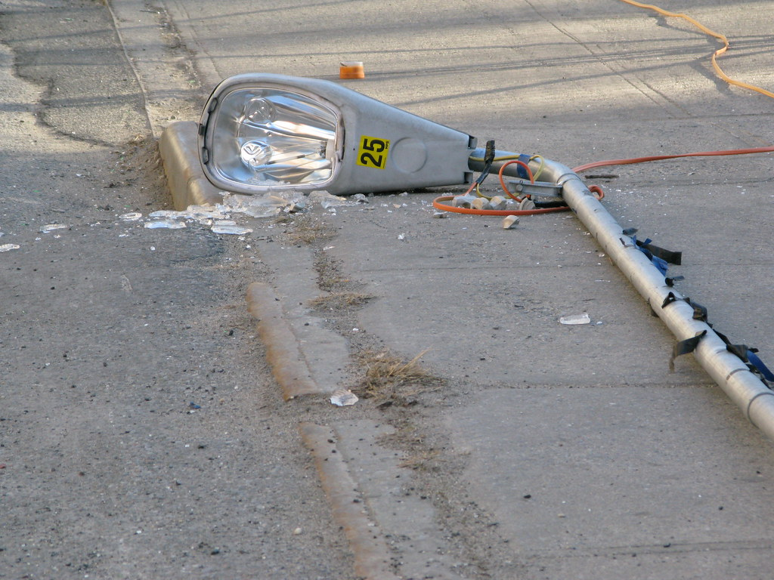
Problem definition: What is the problem?
Many communities in South Africa experience faulty streetlights and electricity related infrastructure problems that are not detected or reported immediately. Often, faults are only identified when residents notice malfunctioning streetlights and report them to their local municipality. This results in delays in fault detection and maintenance, potentially compromising public safety, increasing maintenance costs, and contributing to unnecessary electricity wastage. The problem is directly relevant to the Fourth Industrial Revolution (4IR) because it presents an opportunity to apply Artificial Intelligence (AI), the Internet of Things (IoT), machine learning and automation to improve traditional municipal services. IoT sensors can collect streetlight operating information, including voltage, current, temperature and operating status

Slide 4
AI SOLUTION-
Semifori Elec Tech (Smart Light AI)
Our proposed AI solution is an intelligent streetlight and electricity fault detection system that uses machine learning to identify and classify electrical faults. The system analyses streetlight operating data, including voltage, current fluctuations, power consumption, and temperature, to detect abnormal conditions and potential failures.
Using Python and a Random Forest machine learning model, the system identifies faults such as bulb failures, short circuits, voltage surges, and flickering. The results are displayed on a monitoring dashboard, helping municipalities identify problematic streetlights and prioritise maintenance. Ultimately, Smart Light AI aims to help municipalities detect infrastructure problems earlier, improve maintenance responses and create safer, more sustainable communities.

Slide 5
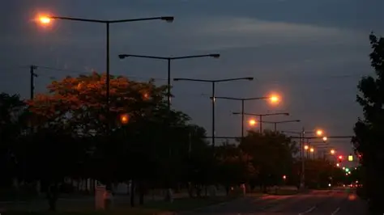
Business objectives:
Business Background
Local municipalities in South Africa face significant challenges in maintaining public streetlight infrastructure and electrical distribution networks. Faults such as burnt-out bulbs, voltage drops, short circuits, cable disruptions, and equipment overheating can compromise public safety, increase maintenance costs, and contribute to electricity wastage. Traditional maintenance processes often depend on residents reporting faulty streetlights or maintenance teams conducting physical inspections. This can delay fault identification and repairs.

Slide 6
Business objectives: (Cont..)
The main business objectives of Semifori Elec Tech (Smart Light AI) are:
  Automate fault detection: Use artificial intelligence and machine learning to analyse streetlight operating data and automatically identify abnormal conditions and potential electrical faults.
  Improve fault identification: by classifying streetlight conditions into five categories: No Fault, Bulb Failure, Short Circuit, Voltage Surge, and Light Flickering.
  Reduce maintenance delays: Help municipalities identify faulty streetlights earlier and prioritise maintenance activities to improve repair response times. •
  Improve infrastructure monitoring: Provide a centralised monitoring dashboard that displays streetlight records, AI predictions, and maintenance statuses.
  Optimise maintenance resources: Help municipalities reduce unnecessary physical inspections and allocate maintenance teams more efficiently.

Slide 7
How beneficial will it be in solving the problem?
Semifori Elec Tech will benefit municipalities and communities by improving fault detection, supporting faster maintenance responses and reducing dependence on manual reporting. The system will help municipalities identify problematic streetlights, prioritise maintenance activities, minimise unnecessary electricity consumption and use maintenance resources more efficiently. Ultimately, it aims to improve public safety, strengthen municipal service delivery and promote environmental sustainability.

Slide 8
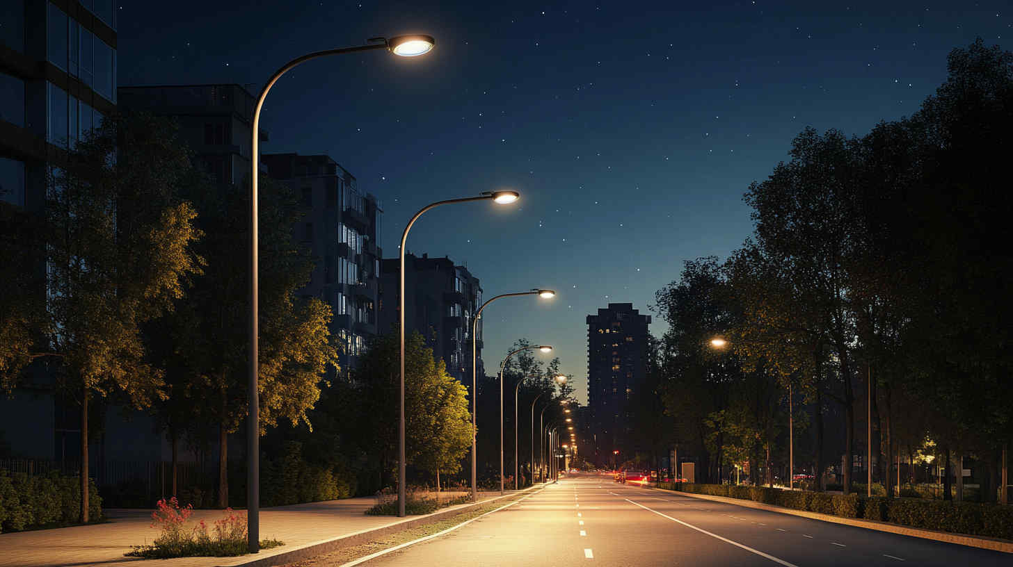
How these techniques improve the solution
The techniques are not included independently. They contribute to improving different aspects of the system. Data augmentation investigates class representation, hyperparameter tuning investigates model configurations, threshold optimisation examines fault detection trade-offs, and cross-validation assesses consistency. Together, these techniques provide a structured approach to developing and evaluating an AI model that is appropriate for streetlight fault detection

Slide 9
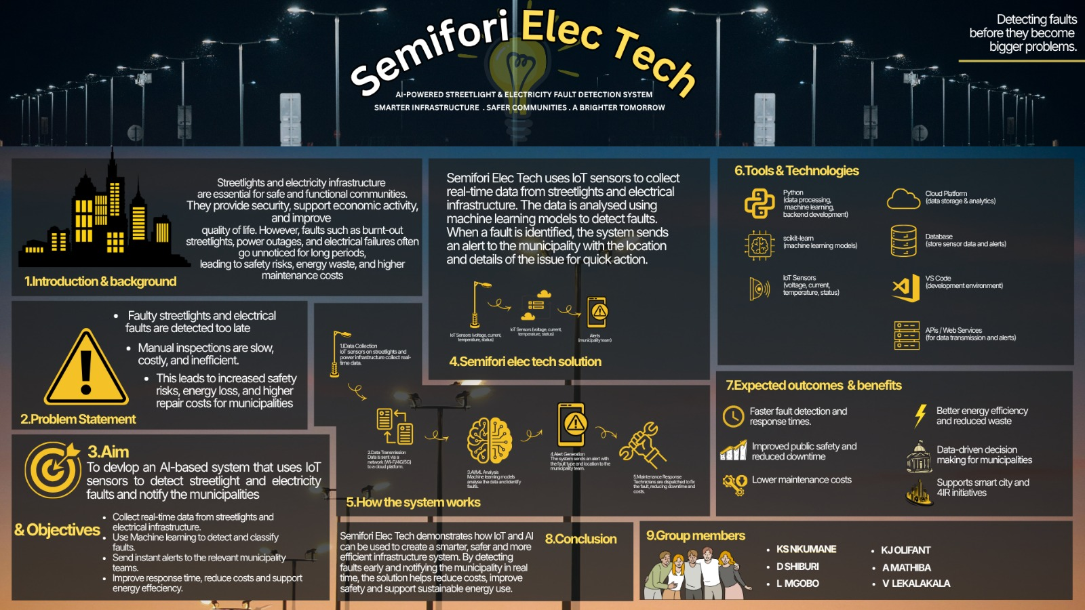
Project poster

